Slide 1
Power BI Security Best Practices
Ted Pattison – Power BI MVP

Slide 2
Agenda
User Authentication and Identity
Data Security
Compliance and Market Availability
Secure Data using RLS

Slide 3
Power BI Built on top of Azure AD
Azure AD manages identity in Microsoft cloud
Organization creates user accounts & groups in Azure AD
Users accounts and groups created in scope of tenant
Azure AD provides user authentication service
Azure AD manages licensing and permissions
Provides users authorized access to Office 365
Provides users authorized access to SharePoint Online
Provides users authorized access to Dynamics 365
Provides users authorized access to Power BI

Slide 4
Managing User Accounts and Groups
Microsoft SaaS Applications
Office 365
Dynamics 365
SharePoint Online
Power BI
Azure User Account Management
Office 365 Admin
Azure Portal
In Tune
Azure Active Directory
Organizational Tenant (e.g. cpt0926.onMicrosoft.com)
User Accounts
Groups
Applications

Slide 5
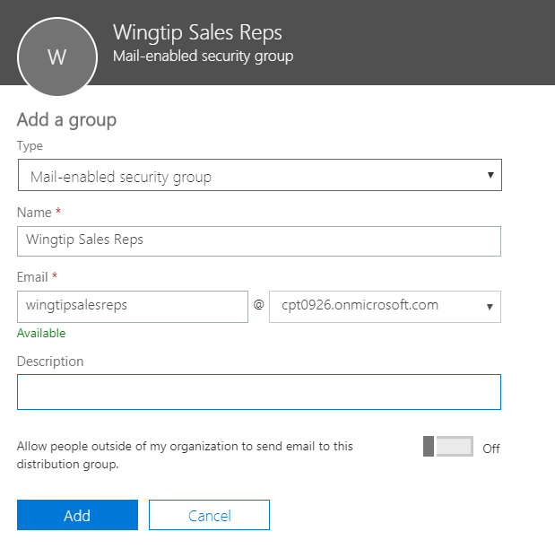
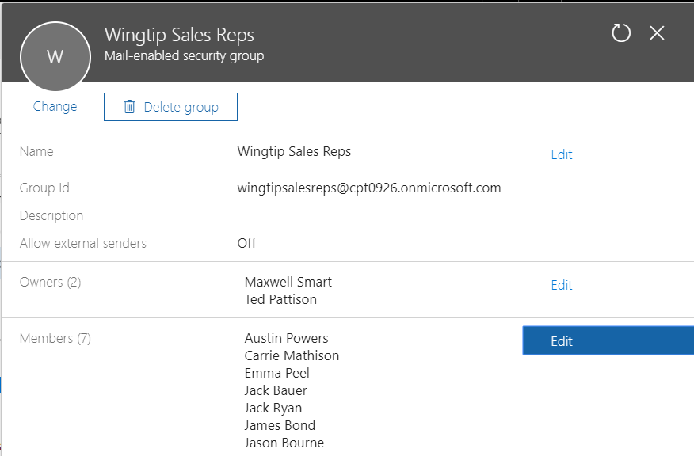
Mail-Enabled Security Groups

Slide 6
Organizations and Azure Active Directory
Simple case where company starts from scratch
Company starts in Azure AD and creates user accounts
Admin takeover possible to user-created tenants
Migrating from On-Premises Active Directory
This is what is known as “hybrid scenario”
Managed identities (w/ or w/o password sync)
Migration managed by IT dept using AAD Connect

Slide 7
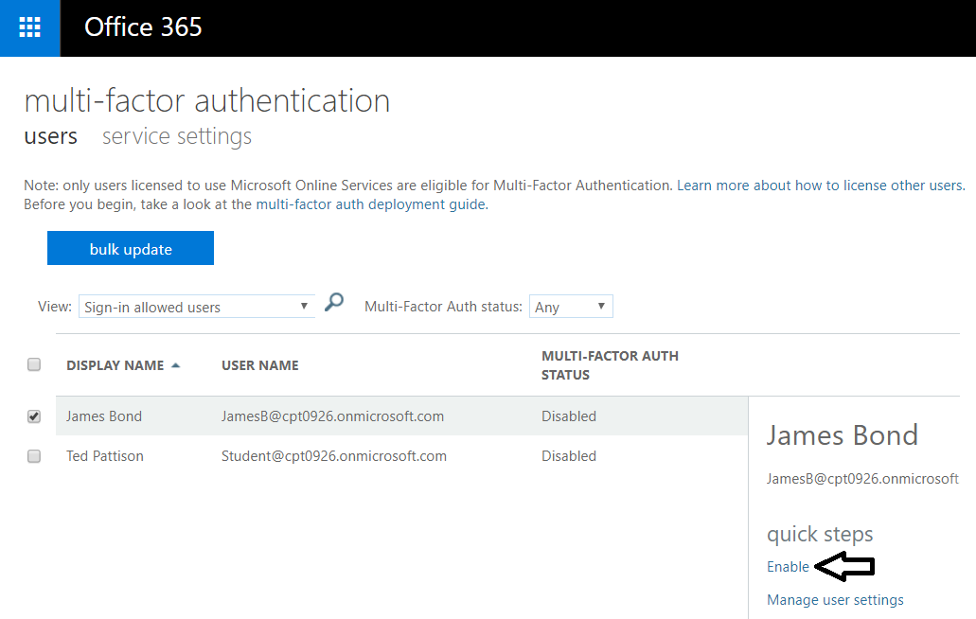
Multifactor Authentication
Enabled through admin portal
Requires Office 365 or Azure AD Premium

Slide 8
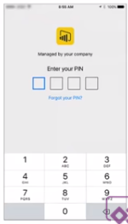
User Access Control for Mobile Devices
Mobile Device Power BI App Management
Controlled via InTune for iPhone (iOS7) and Android
Policy can be configured to make users enter PIN
Account locked after max number of failed PIN logins
Configuring the Power BI app with InTune
Specify the Power BI app as the app to configure
Configure policies (e.g. require PIN)
Enable for deployment
Users install Power BI app from company portal

Slide 9
Conditional Access for Web and Mobile
Azure AD supports configuring conditional access
Control which IP address ranges can connect (Corp LAN)
Control which devices can connect
Configure access so only group members can connect
Configure which users or IP address ranges require 2FA
Lots more is possible

Slide 10
Power BI Licensing
Licenses are assigned to user
Free license
Power BI Pro
Power BI premium allows for anonymous users

Slide 11
Power BI Admin Control
Administrators control sign up for Power BI
whether users can self-register for Power BI
Can assign Power BI free licenses and pro licenses
Assignment done in Office 365 admin center
Administrators have fine grained control
Control who can share content
Control who can export
Control who can create content packs

Slide 12
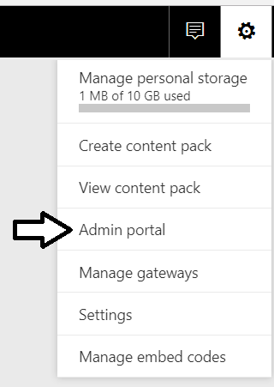
Power BI Admin Portal

Slide 13
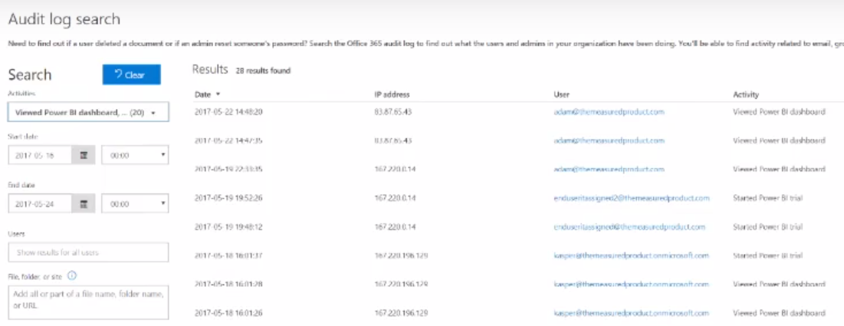
Power BI Audit Logs

Slide 14
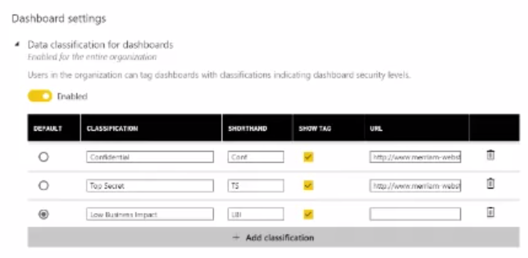
Data Classification

Slide 15
Agenda
User Authentication and Identity
Data Security
Compliance and Market Availability
Secure Data using RLS

Slide 16
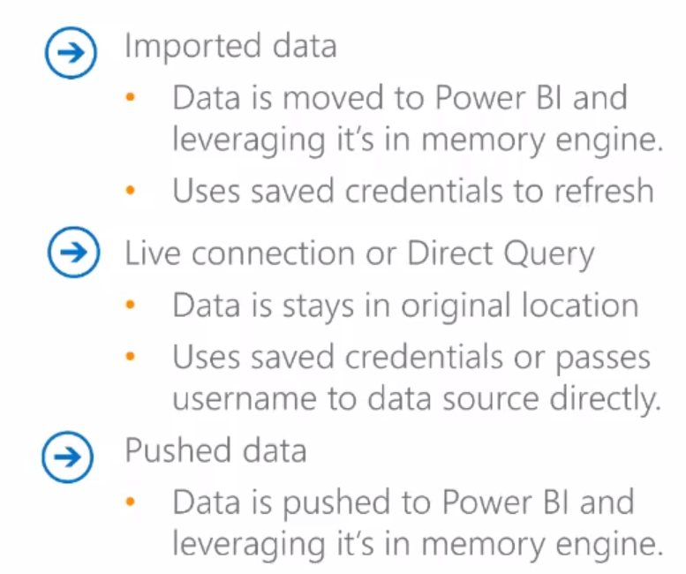
Types of Data
Azure AD
Cloud
On-premises
Local AD

Slide 17
Data Is Always in One of Three States
Data can be In Transit
Moving between data source and Power BI
Moving between Power BI and client
In Transit data is always encrypted with HTTPS/SSL
Data can be In Process
Data can be At Rest
in Power BI is in one of three states
In transit
In Process
At Rest

Slide 18
Storage of Data At Rest
What types of data must be stored?
Data (i.e. Dataset)
Credentials
Metadata for report and dashboard layouts
Visual Cache

Slide 19
Data At Rest Matrix
All data is encrypted
Data source | Data | Metadata | Credentials
Imported Data | Azure Blob Storage | Azure Blob Storage | Azure SQL
Direct Query | Nothing | Azure Blob Storage | Azure SQL
Live Connection | Nothing | Azure Blob Storage | Azure SQL
Push Dataset | Azure SQL | Azure Blob Storage | N/A

Slide 20
Data Encryption
Power BI uses encryption keys for blob storage
Keys stored in separate location from Power BI service
Fully managed by internal Microsoft service
Azure SQL manages encryption internally
Power BI relies on Azure SQL TDE Technology
Used to encrypt credentials to cloud-based sources
For credentials to access on-premises sources
Encryption key created in on-premises data gateway
Encryption key used to encrypt creds stored in cloud

Slide 21
On-premises Data Gateway Encryption
On-premises data gateway encrypts credentials
Local encryption key created by entering recovery key
Used to encrypt on-premises data source credentials
Once encrypted, credentials can be stored in cloud
Local gateway server performs encryption/decryption

Slide 22
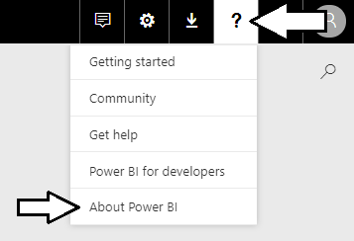
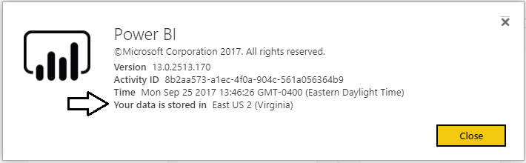
Data Storage Location
Data storage location can be important
Especially with European rules and regulations
Organization has tenant in specific data center

Slide 23
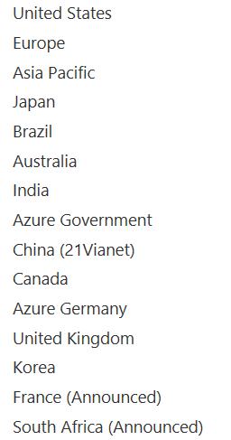
Data Residency and Sovereignty
Some customers must meet requirements
Data must reside in particular geographical location
Azure provides regions to meet requirements

Slide 24
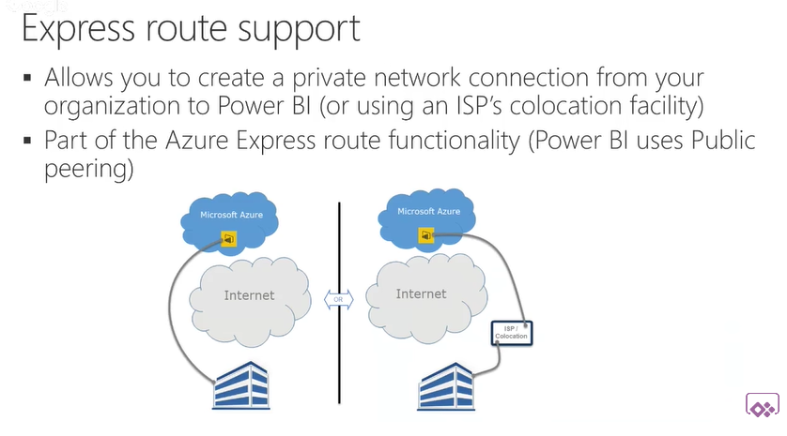
Express Route

Slide 25
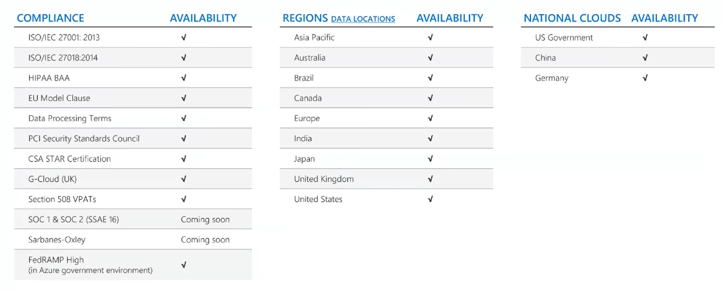
Compliance and Market Availability

Slide 26
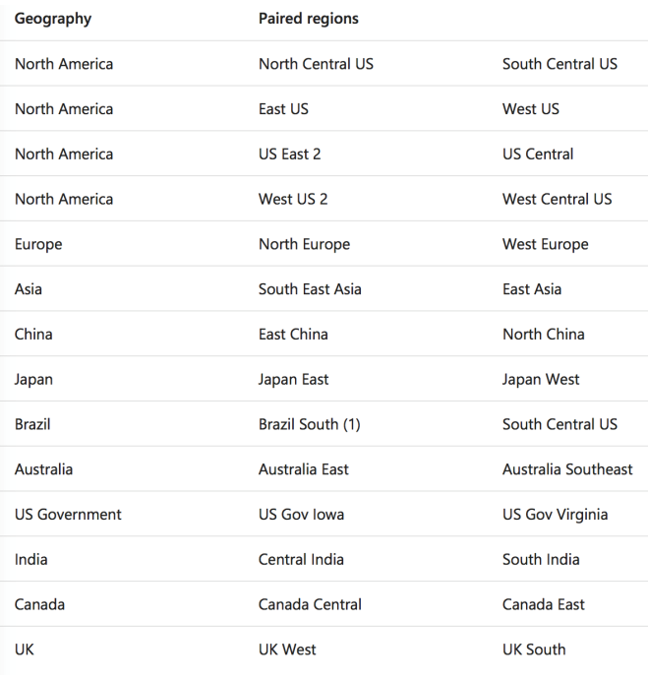
Azure Region Pairs
Data stored in at least 2 data centers
All data centers will exist within the same data region

Slide 27
Agenda
User Authentication and Identity
Data Security
Compliance and Market Availability
Secure Data using RLS

Slide 28
Agenda
User Authentication and Identity
Data Security
Compliance and Market Availability
Secure Data using RLS

Slide 29
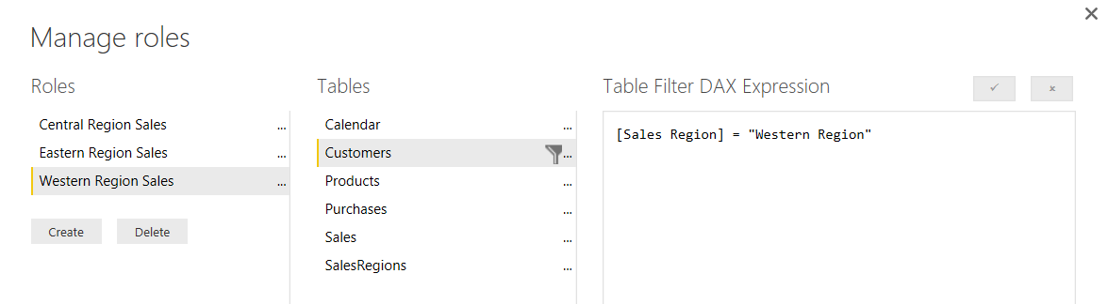
What Is Row-level Security (RLS)
Security Scheme based on Named Roles
Roles are defined using Power BI Desktop
Each role is scoped to the dataset within a PBIX project
Role defined using one or more DAX expressions
DAX expressions restrict which rows are accessible

Slide 30
Dynamic RLS
Design pattern for data-driven security
RLS set up to use login name of current user
Permission assignments are included in dataset
Implemented using bi-directional cross-filtering
Bi directional relationships explicitly filter data when the columns are actually used on axis, rows, columns or filters
RLS implicitly filters data based on the expressions defined in the roles

Slide 31
What Exactly is an App Workspace?
App Workspace is Power BI resource container
Provides storage for datasets, reports and dashboards
App Workspace created as Office 365 Group
Acts as both a security group and distribution list
Requires provisioning SharePoint team site
On the Power BI Roadmap
Creating workspace without SharePoint provisioning

Slide 32
Old Distribution Model
Dev Workspace
read/write
Production Workspace
Read-only
Organizational Content Pack

Slide 33
New Distribution Model
App Workspace
read/write
Installed App
Read-only
Published App

Slide 34
Configuring Row-level Security

Slide 35
Summary
User Authentication and Identity
Data Security
Compliance and Market Availability
Secure Data using RLS

